Slide 1
Domain ML
Technology: Python
PARKINSON’S DISEASE DETECTION

Slide 2
INDEX
Abstract
Objective of project
Problem Statement
Scope & Motivation
Introduction
Literature survey
Existing Method
Disadvantages
Proposed method
Advantages
Project Flow
Hardware and Software Requirements
Architecture
Modules
Algorithm
UML
References

Slide 3
ABSTRACT
Parkinson’s Disease (PD) is a progressive neurodegenerative disorder affecting millions globally, characterized by tremors, stiffness, slowness, and impaired balance. Early detection of PD is crucial for effective diagnosis and management. This project, "Parkinson’s Disease Detection Using Deep Learning Techniques," aims to develop a machine learning model utilizing Convolutional Neural Networks (CNN) and Support Vector Machines (SVM) and Random Forest to analyze speech features from the dataset provided. By focusing on speech characteristics such as frequency, intensity, and timing, the project seeks to improve diagnostic accuracy and support clinical decision-making. The model's implementation could lead to early PD detection, offering benefits such as better treatment options, enhanced patient quality of life, and reduced healthcare costs. Additionally, an frequently ask question related to Parkinson’s Disease.
Keywords: Parkinson’s Disease, Speech Analysis, Deep Learning, Convolutional Neural Networks, Support Vector Machines, Early Detection, Diagnostic Accuracy, Machine Learning, Healthcare.

Slide 4
OBJECTIVE OF PROJECT
The primary objective of the project "Parkinson’s Disease Detection Using Deep Learning Techniques" is to develop an advanced machine learning model that leverages Convolutional Neural Networks (CNN), Support Vector Machines (SVM), and Random Forest algorithms to analyze speech features for early detection of Parkinson’s Disease (PD). By focusing on key speech characteristics such as frequency, intensity, and timing, the project aims to enhance diagnostic accuracy, support clinical decision-making, and ultimately improve patient outcomes through early intervention, better treatment options, and reduced healthcare costs.

Slide 5
PROBLEM STATEMENT
Parkinson’s Disease (PD) is a debilitating neurodegenerative disorder with early symptoms that are often subtle and challenging to diagnose. The lack of reliable early detection methods can delay diagnosis and treatment, impacting patient outcomes and increasing healthcare costs. This project addresses the need for an accurate and early diagnostic tool by leveraging advanced deep learning techniques. By analyzing speech features using Convolutional Neural Networks (CNN), Support Vector Machines (SVM), and Random Forest, this project aims to enhance diagnostic accuracy for Parkinson’s Disease, improving patient care and clinical decision-making.

Slide 6
MOTIVATION
Parkinson’s Disease (PD) poses significant challenges due to its gradual onset and impact on motor functions. Early and accurate diagnosis is crucial for managing the disease effectively and improving patient outcomes. Our project, "Parkinson’s Disease Detection Using Deep Learning Techniques," aims to address this need by leveraging advanced machine learning models, including Convolutional Neural Networks (CNN), Support Vector Machines (SVM), and Random Forest. By analyzing speech features, which are often altered in PD, we seek to enhance diagnostic precision, facilitating timely interventions and better management of the disease.

Slide 7
SCOPE
This project aims to enhance Parkinson’s Disease (PD) detection through advanced deep learning techniques. By employing Convolutional Neural Networks (CNN), Support Vector Machines (SVM), and Random Forest, the project will analyze speech features such as frequency, intensity, and timing to improve diagnostic accuracy. The scope includes developing a machine learning model for early PD detection, which can lead to better treatment options, improved patient quality of life, and reduced healthcare costs. Additionally, it will address common questions related to Parkinson’s Disease for comprehensive understanding.

Slide 8
INTRODUCTION
Parkinson’s Disease (PD) is a chronic and progressive neurodegenerative disorder that poses a significant challenge to global healthcare. Affecting millions of individuals worldwide, PD is primarily characterized by a range of motor symptoms including tremors, stiffness, bradykinesia (slowness of movement), and impaired balance. These symptoms, which develop gradually over time, can severely impact the quality of life, making early detection and intervention crucial for effective disease management and improved patient outcomes. Early diagnosis of Parkinson’s Disease is often challenging due to the subtlety of initial symptoms and the variability in how the disease manifests among individuals. Traditional diagnostic methods, which include clinical assessments and imaging techniques, may not always provide timely or accurate results. Thus, there is a pressing need for innovative approaches to enhance early detection capabilities. This project, titled "Parkinson’s Disease Detection Using Deep Learning Techniques," seeks to address this need by leveraging advanced machine learning methodologies.

Slide 9
The primary focus is on analyzing speech features, as vocal characteristics such as frequency, intensity, and timing have been shown to exhibit distinct patterns in individuals with Parkinson’s Disease. By employing Convolutional Neural Networks (CNN), Support Vector Machines (SVM), and Random Forest algorithms, this project aims to develop a robust model capable of detecting Parkinson’s Disease at an early stage through speech analysis. The implementation of such a model holds significant potential benefits, including improved diagnostic accuracy, more effective treatment options, and enhanced patient quality of life. Additionally, it could contribute to reducing healthcare costs associated with late-stage diagnosis and treatment. This project not only aims to advance the field of PD detection but also seeks to provide valuable insights and tools for clinical decision-making.

Slide 10
LITERATURE SURVEY
S.NO | YEAR | AUTHORS | TITLE | OUT COMES
1 | 2020 | Abirami S., Chitra P. | Energy-efficient edge based real-time healthcare support system. | It looks like you’re referencing a paper related to energy-efficient real-time healthcare support systems using wearable IoT devices. If you need a summary or analysis of the abstract or specific details from the paper, feel free to provide more context or let me know what you need!
2 | 2016 | Al-Fatlawi A. H., Jabardi M. H., Ling S. H. | “Efficient diagnosis system for parkinson's disease using deep belief network,” | Early diagnosis of Parkinson’s disease (PD) is crucial for effective treatment and management of the condition. This paper presents an efficient diagnostic system for PD utilizing a Deep Belief Network (DBN). The proposed system aims to enhance diagnostic accuracy and reduce the computational complexity associated with traditional methods. The DBN is trained using a dataset of PD patients, with a focus on extracting relevant features and learning complex patterns associated with the disease. Experimental results demonstrate the effectiveness of the DBN in achieving high accuracy rates while maintaining computational efficiency. The paper discusses the potential of DBNs in medical diagnosis and their implications for early detection and intervention strategies.

Slide 11
S.NO | YEAR | AUTHORS | TITLE | OUT COMES
3 | 2020 | Bilgen I., Guvercin G., Rekik I. | Machine learning methods for brain network classification: application to autism diagnosis using cortical morphological networks. | It looks like you're referencing a paper on machine learning methods for brain network classification related to autism diagnosis. The abstract seems to be about predicting the Unified Parkinson's Disease Rating Scale (UPDRS) scores.To provide you with more relevant information, could you please clarify how you would like to use this reference? Are you looking for a summary, an explanation of its methods, or something else?
4 | 2021 | Charbuty B., Abdulazeez A. | Classification based on decision tree algorithm for machine learning. J. | It looks like you're referencing a paper on decision tree classifiers in machine learning. Based on the abstract snippet provided, the paper seems to discuss the prominence of decision tree algorithms in data classification and their various applications.

Slide 12
S.NO | YEAR | AUTHORS | TITLE | OUT COMES
5 | 2020 | Fothergill-Misbah N., Maroo H., Hooker J., Kwasa J., Walker R. | Parkinson's disease medication in kenya–situation analysis. Pharmaceutica l J. Kenya. 24, 38–41. | Addressing the gaps in medication availability and healthcare infrastructure is crucial for improving the quality of life for Parkinson’s disease patients in Kenya. Recommendations include increasing funding for Parkinson’s disease treatments, expanding healthcare training, and developing more robust distribution networks to ensure equitable access to necessary medications.
6 | 2019 | Hossain E., Hossain M. F., Rahaman M. A. | “A color and texture based approach for the detection and classification of plant leaf disease using knn classifier,” | It seems like you're referencing a paper or study authored by Hossain E., Hossain M. F., and Rahaman M. A. from 2019. Could you provide more details or specify what information you need about this reference? For example, are you looking for a summary of the study, information about the authors, or something else?

Slide 13
EXISTING SYSTEM
Current methods for Parkinson’s Disease (PD) diagnosis primarily involve clinical assessments and neurological examinations, which often detect symptoms only in later stages. Conventional diagnostic tools include motor function tests and subjective evaluations of speech and movement. Although some systems utilize speech analysis, they typically rely on manual feature extraction and traditional statistical methods, which may lack the precision and efficiency of modern machine learning techniques.

Slide 14
DISADVANTAGES
Late Detection: Traditional methods often identify Parkinson’s Disease at more advanced stages, reducing the effectiveness of early intervention and treatment options.
Subjectivity: Clinical assessments and neurological evaluations can be subjective, leading to variability in diagnoses and potential inconsistencies in patient evaluation.
Manual Feature Extraction: Existing systems that use speech analysis frequently rely on manual feature extraction and traditional statistical techniques, which may lack precision and fail to capture subtle patterns indicative of PD.
Scalability Issues: Current diagnostic methods can be resource-intensive and may not easily scale for large populations, limiting their accessibility and efficiency in widespread screening and diagnosis.

Slide 15
PROPOSED METHOD
The proposed system aims to enhance Parkinson’s Disease (PD) detection through advanced deep learning techniques. Utilizing Convolutional Neural Networks (CNN) and Support Vector Machines (SVM) and Random Forest, this system will analyze speech features extracted from the dataset to identify subtle patterns associated with PD. By employing these state-of-the-art machine learning algorithms, the system promises more accurate and early diagnosis compared to traditional methods. The CNN will automatically learn and extract relevant features from speech data, while the SVM will classify the presence of PD with high precision. Additionally, an frequently ask question related to Parkinson’s Disease.

Slide 16
ADVANTAGES
Early Detection: The use of deep learning techniques allows for the early identification of Parkinson’s Disease by analyzing subtle speech patterns, enabling timely intervention and treatment.
High Accuracy: Convolutional Neural Networks (CNN) and Support Vector Machines (SVM) provide precise classification of speech features, leading to more accurate diagnoses compared to traditional methods.

Slide 17
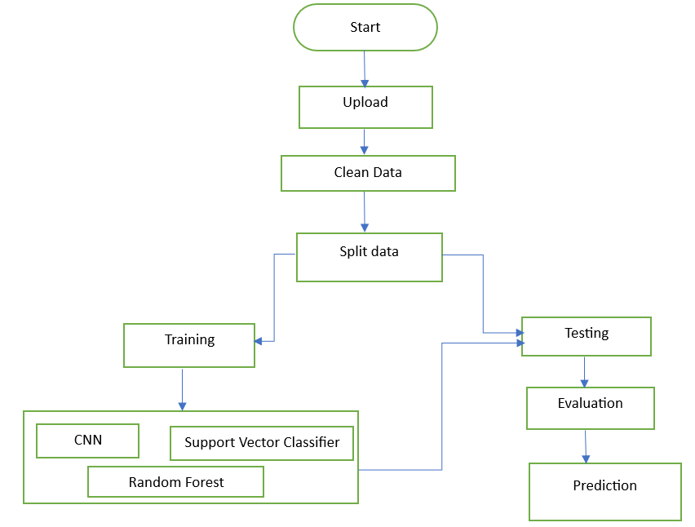
BLOCK DIAGRAM

Slide 18
HARDWARE & SOFTWARE REQUIREMENTS
SOFTWARE REQUIREMENS
Operating System : Windows 7/8/10
Server side Script : HTML, CSS, Bootstrap & JS
Programming Language : Python
Libraries : Flask, Pandas, Mysql.connector, Os, Smtplib, Numpy
IDE/Workbench : PyCharm, VS-Code
Technology : Python 3.6+
Server Deployment : Xampp Server
Database : MySQL

Slide 19
HARDWARE & SOFTWARE REQUIREMENTS
HARDWARE REQUIREMENTS
Processor - I5/Intel Processor
RAM - 8GB (min)
Hard Disk - 160 GB
Key Board - Standard Windows Keyboard
Mouse - Two or Three Button Mouse
Monitor - Any

Slide 20
FUNCTIONAL AND NON-FUNCTIONAL REQUIREMENTS
Requirement’s analysis is very critical process that enables the success of a system or software project to be assessed. Requirements are generally split into two types: Functional and non-functional requirements.
Functional Requirements: These are the requirements that the end user specifically demands as basic facilities that the system should offer. All these functionalities need to be necessarily incorporated into the system as a part of the contract. These are represented or stated in the form of input to be given to the system, the operation performed and the output expected. They are basically the requirements stated by the user which one can see directly in the final product, unlike the non-functional requirements.

Slide 21
FUNCTIONAL AND NON-FUNCTIONAL REQUIREMENTS
Examples of functional requirements:
Authentication of user whenever he/she logs into the system
System shutdown in case of a cyber-attack
A verification email is sent to user whenever he/she register for the first time on some software system.
Non-functional requirements: These are basically the quality constraints that the system must satisfy according to the project contract. The priority or extent to which these factors are implemented varies from one project to other. They are also called non-behavioral requirements.

Slide 22
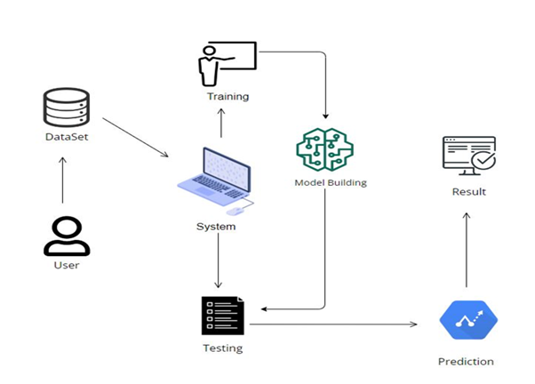
ARCHITECTURE

Slide 23
Modules
User:
View data:
In the view data, the user will View the dataset for modelling.
Input Model:
The user must provide input values for the certain fields in order to get results.
View Results:
User view’s the generated results from the model.
View score:
Here user have ability to view the accuracy in %

Slide 24
System
Working on dataset:
System checks for data whether it is available or not and load the data in csv files.
Pre-processing:
Data need to be pre-processed according the models it helps to increase the accuracy of the model and better information about the data.
Training the data:
After pre-processing the data will split into two parts as train and test data before training with the given algorithms.
Model Building
To create a model that predicts the personality with better accuracy, this module will help user.
Generated Score:
Here user view the score in %
Generate the Result:
Person has a Parkinson Disease or Not

Slide 25
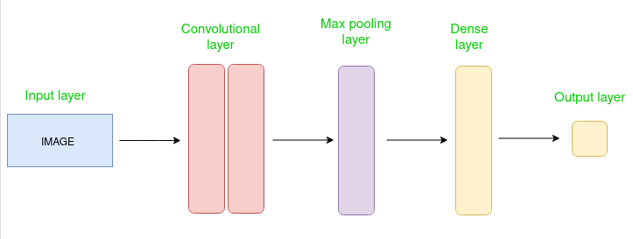
Algorithm
Parkinson's disease detection using Convolutional Neural Networks (CNNs) represents a cutting-edge approach in medical diagnostics. CNNs are a class of deep learning models particularly effective for image and signal processing tasks, making them suitable for analyzing medical imaging data such as MRI scans or hand-drawn spiral tests, often used in Parkinson's disease diagnosis. These networks automatically extract features from input data, identifying subtle patterns indicative of the disease that might be missed by traditional methods. CNNs have been trained on large datasets of medical images or gait patterns to distinguish between healthy individuals and those with Parkinson's disease with high accuracy. This technology holds promise for early detection, allowing for timely intervention and improved patient outcomes. By leveraging the power of CNNs, researchers are advancing the field of neurodegenerative disease diagnostics, pushing the boundaries of how we understand and identify Parkinson's disease in its earliest stages.

Slide 26
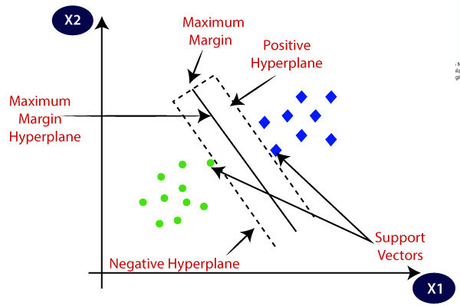
Support Vector Machines (SVM) are a powerful supervised learning technique widely used for Parkinson's disease detection. SVMs work by identifying the optimal hyperplane that separates data points belonging to different classes, in this case, distinguishing between healthy individuals and those with Parkinson's. This is particularly effective in handling high-dimensional datasets, which are common in medical diagnostics. The ability of SVMs to handle both linear and non-linear data makes them versatile for modeling complex relationships in biomedical data. In Parkinson's disease detection, SVMs are often employed to classify voice recordings, handwriting patterns, or other biomarkers that exhibit subtle differences between affected and unaffected individuals. By maximizing the margin between classes, SVMs provide robust classification even with small or noisy datasets. Their effectiveness in feature selection and ability to generalize well make SVMs a valuable tool in early and accurate detection of Parkinson's disease, ultimately aiding in timely intervention and treatment.

Slide 27
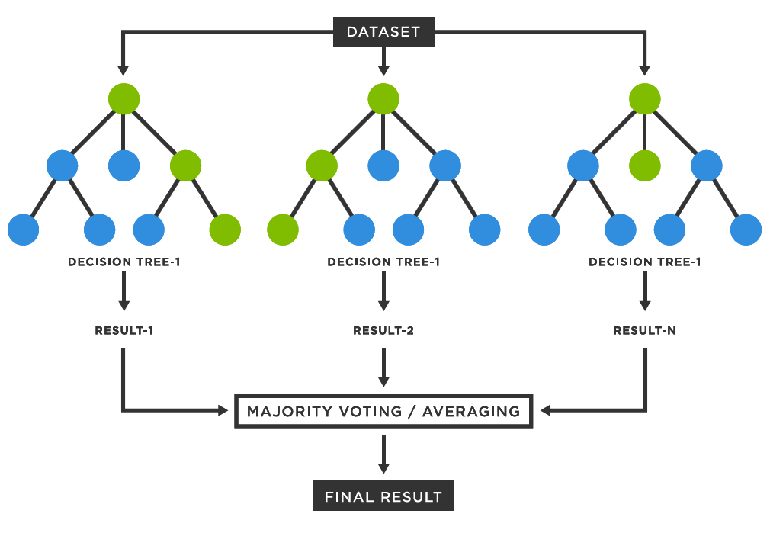
Random Forest is a powerful machine learning algorithm widely used for Parkinson's disease detection. It operates by constructing multiple decision trees during training and outputting the mode of the classes for classification tasks. In Parkinson's disease detection, Random Forest effectively handles the complexity of clinical and voice data, such as speech patterns, motor symptoms, and other biomarkers, by capturing intricate patterns that differentiate Parkinson's patients from healthy individuals. This ensemble learning method is robust against overfitting, ensuring high accuracy even with noisy or limited data. By averaging the predictions of individual trees, Random Forest reduces variance and improves the model's generalization to unseen data. Its ability to rank feature importance aids in identifying key predictors, enhancing interpretability and supporting medical decision-making. Random Forest's adaptability, scalability, and precision make it a valuable tool in developing reliable diagnostic models for early and accurate Parkinson's disease detection.

Slide 28
Use Case Diagram:
1) A use case diagram in the Unified Modeling Language (UML) is a type of behavioral diagram defined by and created from a Use-case analysis.
2) Its purpose is to present a graphical overview of the functionality provided by a system in terms of actors, their goals (represented as use cases), and any dependencies between those use cases.
3) The main purpose of a use case diagram is to show what system functions are performed for which actor. Roles of the actors in the system can be depicted.

Slide 29
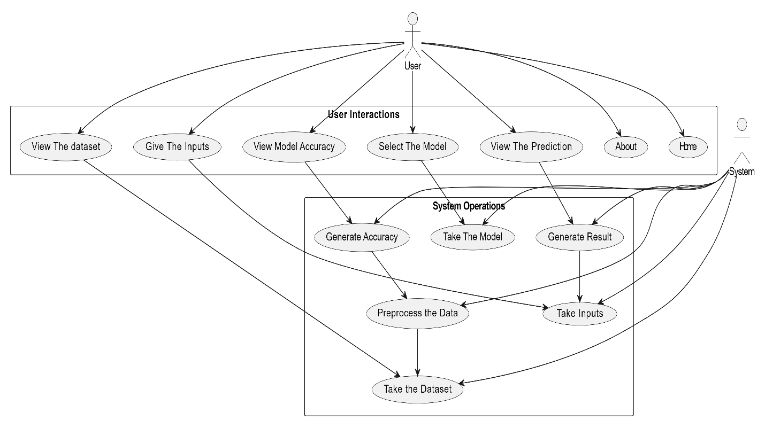
UML DIAGRAMS
Figure: Use Case Diagram

Slide 30
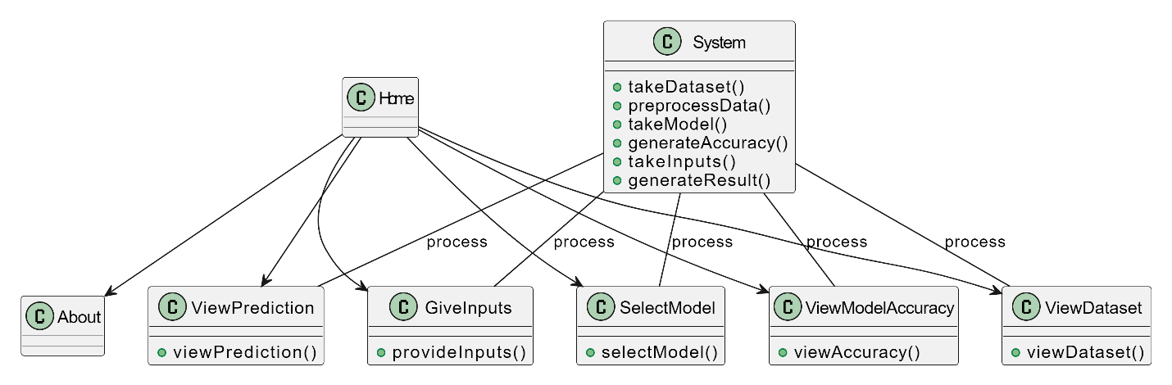
Class Diagram:
In software engineering, a class diagram in the Unified Modeling Language (UML) is a type of static structure diagram that describes the structure of a system by showing the system's classes, their attributes, operations (or methods), and the relationships among the classes. It explains which class contains information

Slide 31
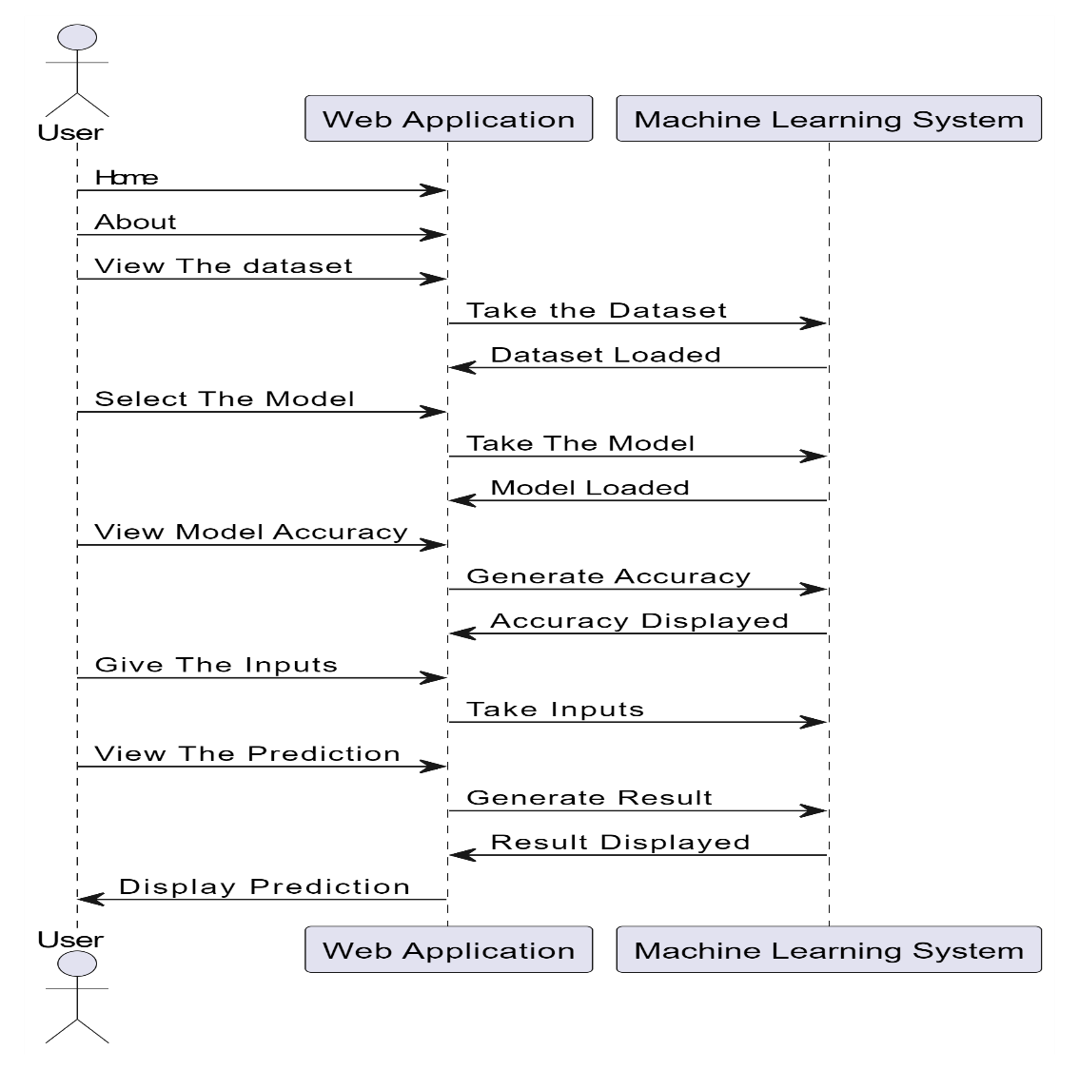
Sequence Diagram:
A sequence diagram in Unified Modeling Language (UML) is a kind of interaction diagram that shows how processes operate with one another and in what order.
It is a construct of a Message Sequence Chart. Sequence diagrams are sometimes called event diagrams, event scenarios, and timing diagrams
Figure: Sequence diagram

Slide 32
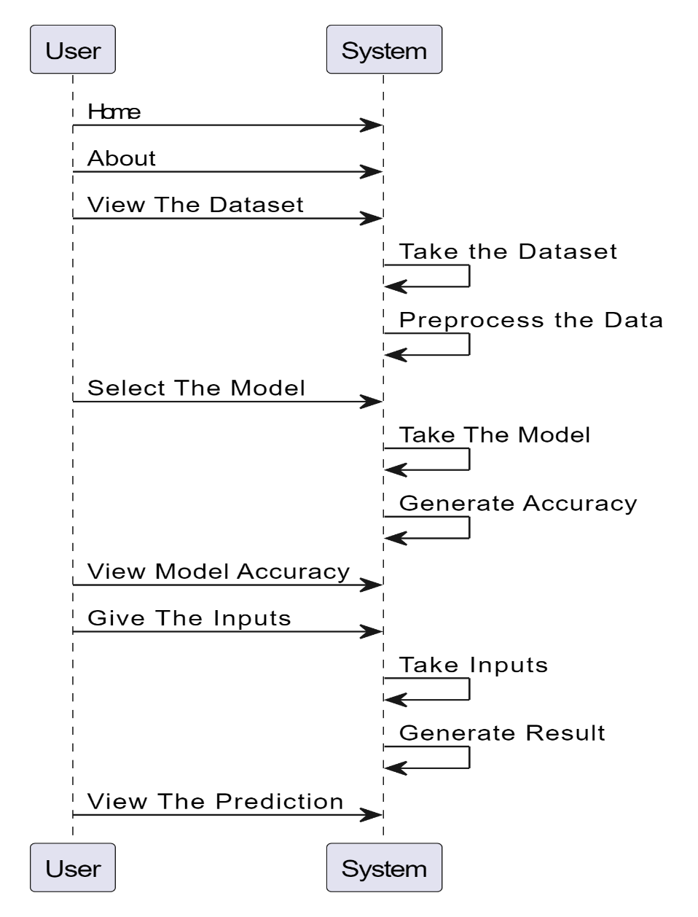
Collaboration Diagram:
In collaboration diagram the method call sequence is indicated by some numbering technique as shown below. The number indicates how the methods are called one after another. We have taken the same order management system to describe the collaboration diagram. The method calls are similar to that of a sequence diagram. But the difference is that the sequence diagram does not describe the object organization whereas the collaboration diagram shows the object organization.
Figure: Collaboration diagram

Slide 33
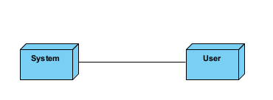
Deployment Diagram
Deployment diagram represents the deployment view of a system. It is related to the component diagram. Because the components are deployed using the deployment diagrams. A deployment diagram consists of nodes. Nodes are nothing but physical hardware’s used to deploy the application.
Figure: Deployment diagram

Slide 34
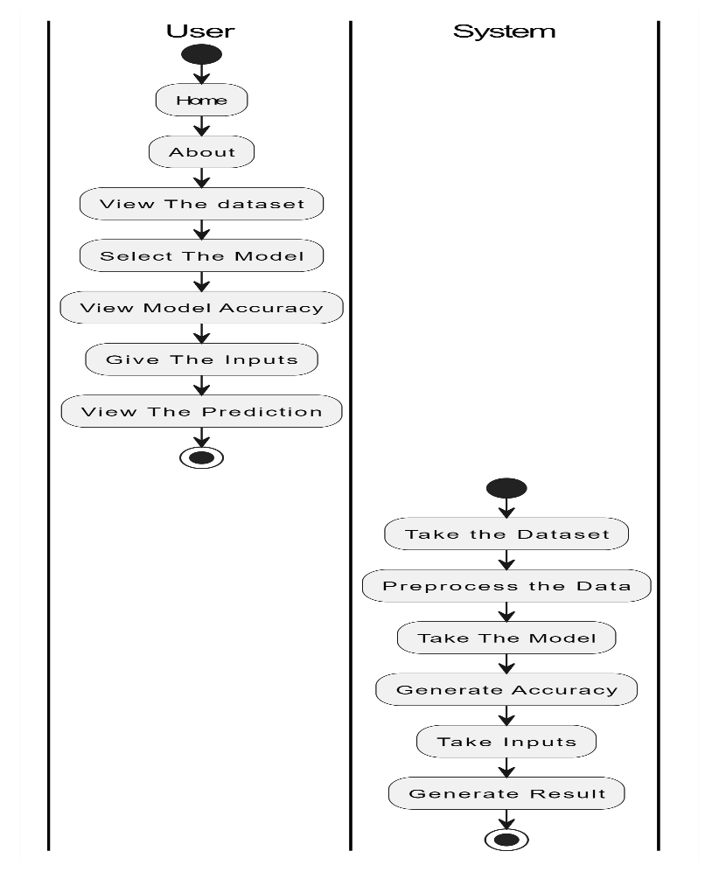
Activity Diagram:
Activity diagrams are graphical representations of workflows of stepwise activities and actions with support for choice, iteration and concurrency. In the Unified Modelling Language, activity diagrams can be used to describe the business and operational step-by-step workflows of components in a system. An activity diagram shows the overall flow of control.
Figure: Activity diagram

Slide 35
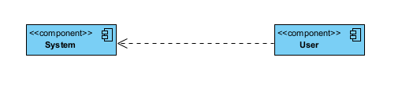
Component Diagram:
A component diagram, also known as a UML component diagram, describes the organization and wiring of the physical components in a system. Component diagrams are often drawn to help model implementation details and double-check that every aspect of the system's required function is covered by planned development.
Figure: Component diagram

Slide 36
UML DIAGRAMS
ER Diagram:
An Entity–relationship model (ER model) describes the structure of a database with the help of a diagram, which is known as Entity Relationship Diagram (ER Diagram). An ER model is a design or blueprint of a database that can later be implemented as a database. The main components of E-R model are: entity set and relationship set.
An ER diagram shows the relationship among entity sets. An entity set is a group of similar entities and these entities can have attributes. In terms of DBMS, an entity is a table or attribute of a table in database, so by showing relationship among tables and their attributes, ER diagram shows the complete logical structure of a database. Let’s have a look at a simple ER diagram to understand this concept.

Slide 37
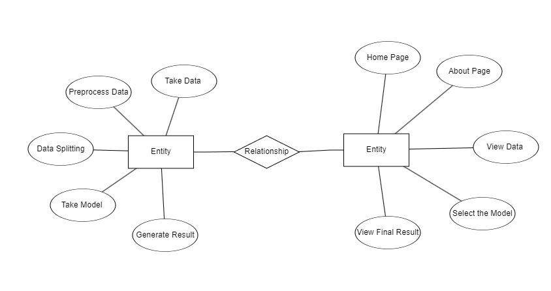
Figure: ER diagram

Slide 38
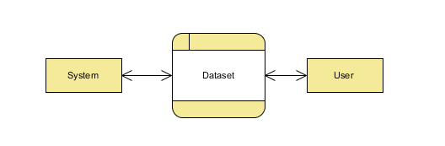
DFD Diagram:
A Data Flow Diagram (DFD) is a traditional way to visualize the information flows within a system. A neat and clear DFD can depict a good amount of the system requirements graphically. It can be manual, automated, or a combination of both. It shows how information enters and leaves the system, what changes the information and where information is stored. The purpose of a DFD is to show the scope and boundaries of a system as a whole. It may be used as a communications tool between a systems analyst and any person who plays a part in the system that acts as the starting point for redesigning a system.
Figure: Context Level diagram

Slide 39
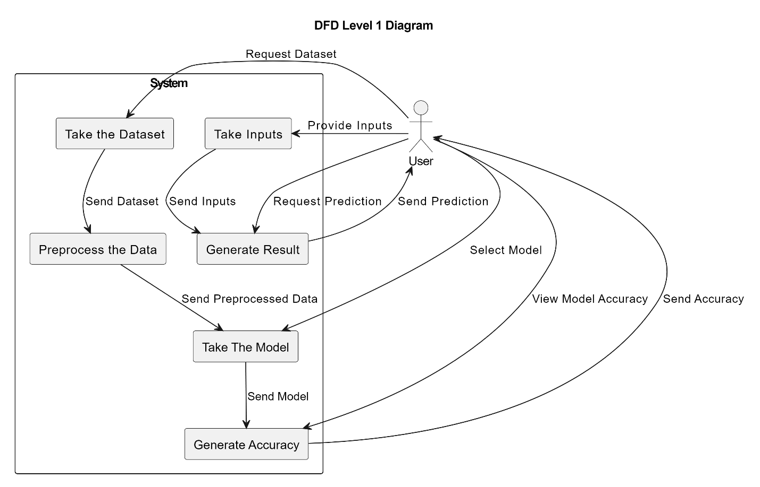
FigureLevel-1 diagram

Slide 40
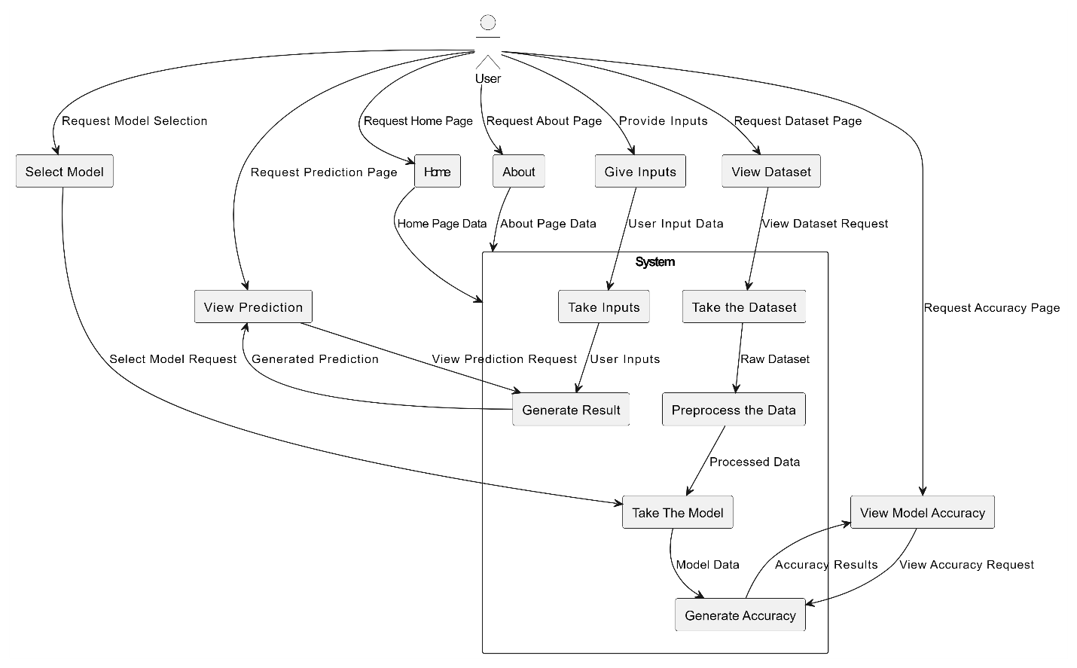
Figure:Level-2 diagram

Slide 41
REFERENCES
1] Abirami S., Chitra P. (2020). Energy-efficient edge based real-time healthcare support system. Adv. Comp. 117, 339–368. 10.1016/bs.adcom.2019.09.007.
2] Al-Fatlawi A. H., Jabardi M. H., Ling S. H. (2016). “Efficient diagnosis system for parkinson's disease using deep belief network,” in 2016 IEEE Congress on evolutionary computation (CEC) (Vancouver, BC, Canada: IEEE; ), 1324–1330. 10.1109/CEC.2016.7743941.
3] Bilgen I., Guvercin G., Rekik I. (2020). Machine learning methods for brain network classification: application to autism diagnosis using cortical morphological networks. J. Neurosci. Meth. 343, 108799. 10.1016/j.jneumeth.2020.108799 [PubMed]
4] Charbuty B., Abdulazeez A. (2021). Classification based on decision tree algorithm for machine learning. J. Appl. Sci. Technol. Trends. 2, 20–28. 10.38094/jastt20165
5] Das R. (2010). A comparison of multiple classification methods for diagnosis of parkinson disease. Expert Syst. Appl. 37, 1568–1572. 10.1016/j.eswa.2009.06.040

Slide 42
6] Desai R. (2019). Top 10 Python Libraries for Data Science. Available online at: https://towardsdatascience.com/top-10-python-libraries-for-data-science-cd82294ec266 (accessed July 3, 2022).
7] Fothergill-Misbah N., Maroo H., Hooker J., Kwasa J., Walker R. (2020). Parkinson's disease medication in kenya–situation analysis. Pharmaceutica l J. Kenya. 24, 38–41.
8] Gil D., Manuel D. J. (2009). Diagnosing parkinson by using artificial neural networks and support vector machines. Glob. J. Comput. Sci. Technol. 9, 63–71.
9] Harel B., Cannizzaro M., Snyder P. J. (2004). Variability in fundamental frequency during speech in prodromal and incipient parkinson's disease: a longitudinal case study. Brain Cognit. 56, 24–29. 10.1016/j.bandc.2004.05.002
10] Hossain E., Hossain M. F., Rahaman M. A. (2019). “A color and texture based approach for the detection and classification of plant leaf disease using knn classifier,” in 2019 International Conference on Electrical, Computer and Communication Engineering (ECCE) (Cox's Bazar: IEEE; ).

